Slide 1
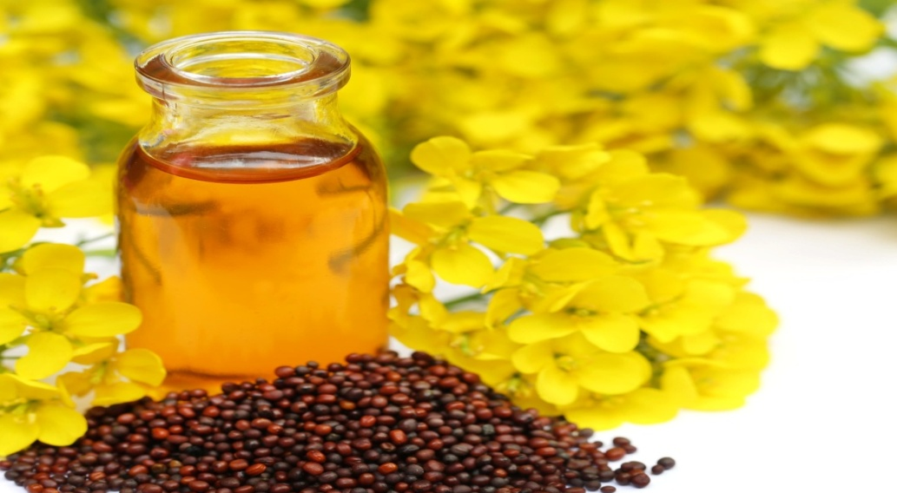
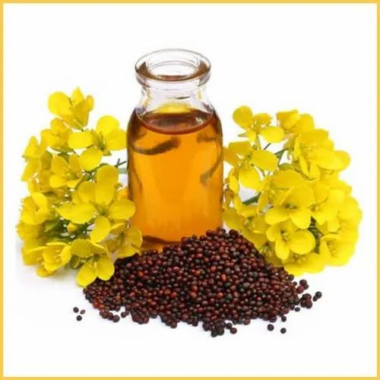
PROJECT ON ENTRPRENEURSHIP
DEVELOPMENT OF MUSTARD OIL FACTORY
MUSTARD OIL
GUIDED BY:-
PR0jectTED BY:-
DR. APURBA GIRI(ASSISTANT PROFESSOR HEAD)
AYAN MONDAL (ASSISTANT PROFESSOR)
Department Of Nutrition
Mugberia Gangadhar Mahavidyalaya
MR. BISWAJIT DAS
Roll- 0432
DEPARTMENT OF NUTRITION
B.Voc (Food Processing,6th Sem)
Mugberia Gangadhar Mahavidyalaya

Slide 3
INTRODUCTION
Mustard oil, which is produced from the seeds of the mustard plant, is a common ingredient in Indian cuisine. Known for its strong flavor, pungent aroma, and high smoke point, it's often used for sautéing and stir-frying vegetables in many parts of the world
Top Mustard Producing States in India
Rajasthan, Haryana, Madhya Pradesh, Uttar Pradesh, West Bengal, Gujarat, Jharkhand, Assam

Slide 4
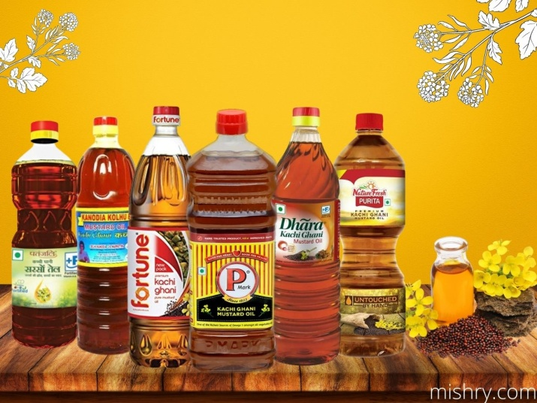
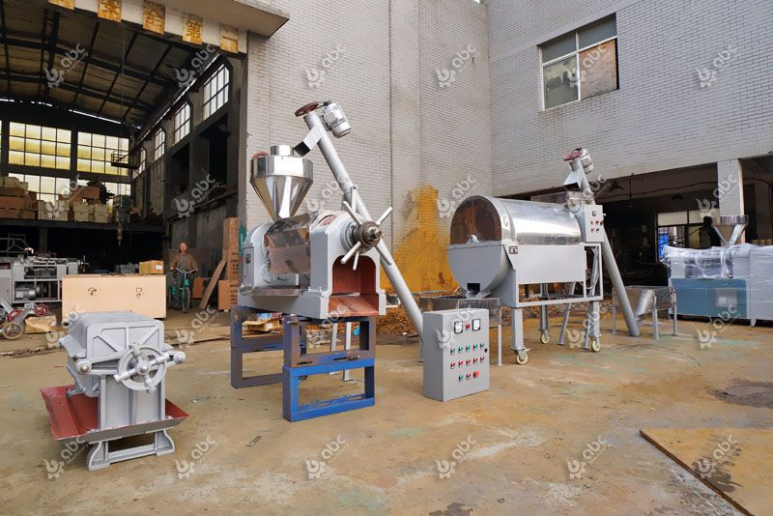
OIL MANUFACTURING BUSINESS
RAW MATERIALS
MACHINERY
INVESMENT
CUSTOMERS
AREA
MANPOWER
PROFIT
LICENSE
MARKET STRATEGY

Slide 5
KNOW THE BUSINESS
DEMAND
SUPPLY
PRICE
QUANTITY
QUALITY

Slide 6
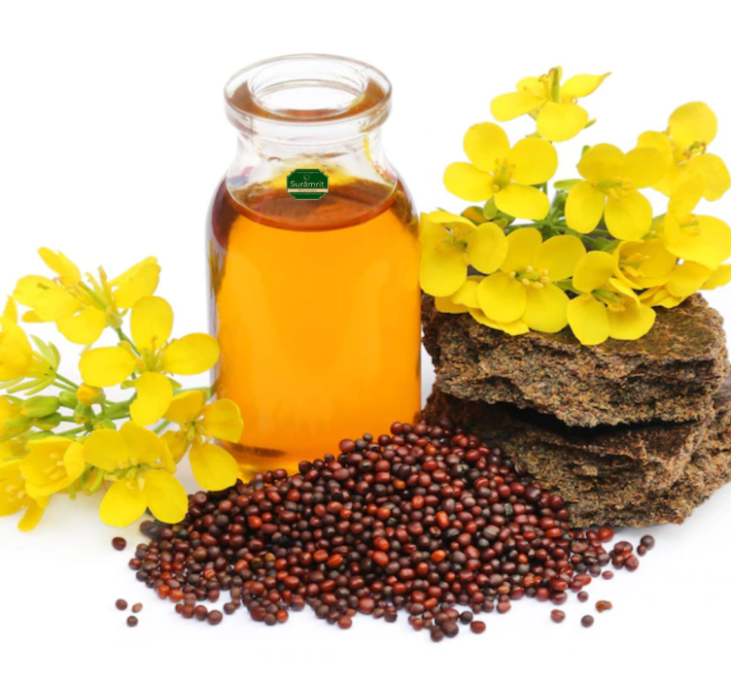
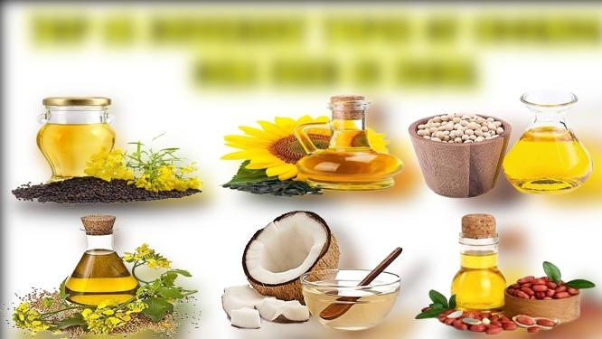
TYPES OF OILS
MUSTARD OIL
OLIVE OIL
REFINED OIL
SESAME OIL
AND MANY MORE

Slide 7
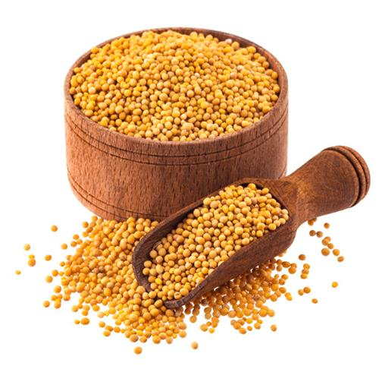
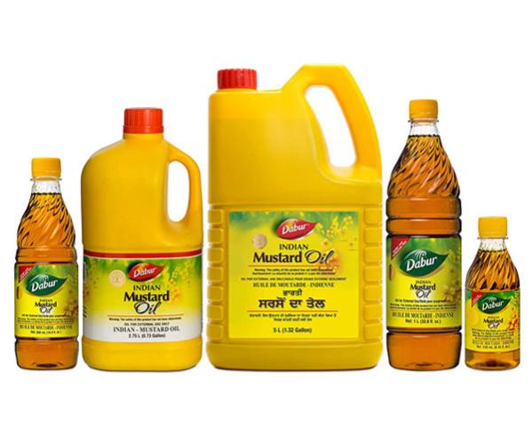
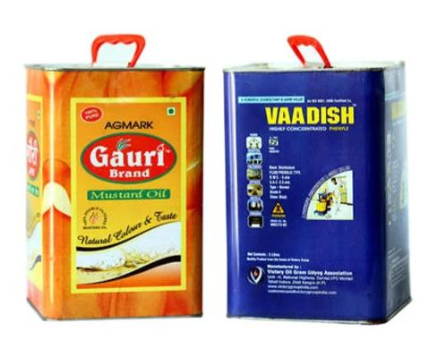
RAW MATERIALS
MUSTARD SEEDS
PACKAGING) MATERIALS
(BOTTLES/TIN/POUCH

Slide 8
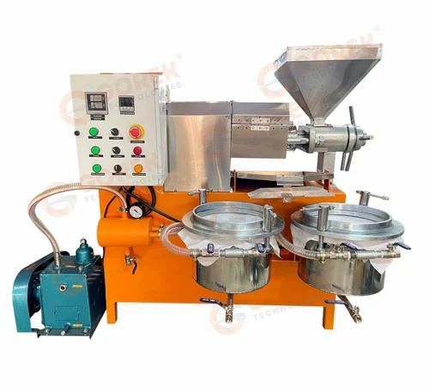
MACHINERY
SCREW EXPELLER
COLD PRESSING
FILTRATION TANK
STORAGE TANK FOR OIL
WEIGHING (ELECTRONIC)
SEALING MACHINE
STAMPING MACHINE
AUTOMATIC

Slide 9
PROCESS
SEEDS ARE COLLECTED
SEEDS ARE CLEANED
COLD PRESSING
OIL COLLECTING TANK
OIL FILTERED
PACKAGING

Slide 10
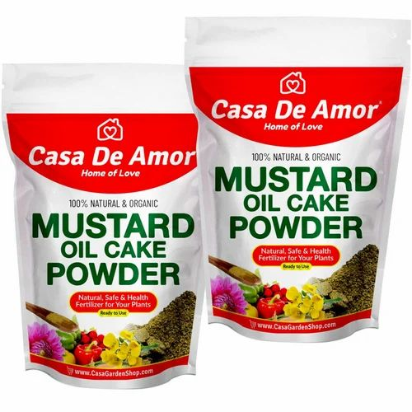
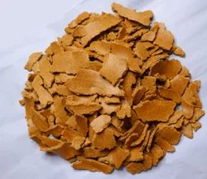
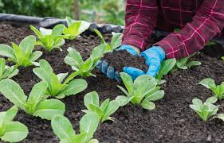
KHALI
The mustard cake powder also known as sarso khali is traditionally used in India as a natural plant food for blooming flowers and vegetable plants.

Slide 11
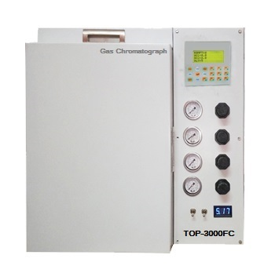
LAB TEST
ERUCIC ACID TEST :
Oil pressed,the oil deriavtized into fatty acid methyl esters and then analyzed by gas chromatography
POLYUNSATURATED FATTY ACID TEST
ANTIOXIDENT TEST
GAS CHROMATOGRAPHY

Slide 12
INVESTMENT
CAPITAL INVESNT
6 TO 10 LAKS
MANUAL
SEMI AUTOMATIC
FULLY AUTOMATIC
INVESTMENT STEPS

Slide 13
PRODUCTION COST
3KG MUSTARD SEDDS = 1 LTR OIL
(MAXIMUM 150)
(SALE 156)
MUSTARD OIL CAKE(KHALI) 2KG = MINIMUM 30
60+6=66

Slide 14
PROFIT
RETURN- 25 TO 30%
DEPENDING ON PRODUCTION
&
BUSINESS MODEL

Slide 15
AREA
1440 SQ FT
MAN POWER
2-3 LABOURS

Slide 16
LICENSE
REGISTRATION OF BUSINESS
LICENSE
NOC FROM STATE POLUTION
CONTROL BOARD
GST
FSSAI
TRADE LICENSE
REGISTRATING FOR
A TRADEMARK

Slide 17
TARGET CUSTOMER
WHOLESALERS
DISTRIBUTORS
RETAILERS
STORES
ONLINE PLATFROM
CAFES
RESTURENT

Slide 18
MARKETING STRATEGIES
FIRSTLY, PERSONAL SELLING
SECONDARY, ADVERTISING
THIRDLY, SALES PROMOTION
FOURTH, DIRECT
MARKETING
LASTLY, PUBLICITY

Slide 19
PLANT LAYOUT

